Slide 1
Probe Data Analysis for Road Slope
Assignment 2
Geospatial Vision / Visualisation
CS – 513
Submitted by:
Bharatiben Kyada (A20353636)
Sharul Saxena (A20380920)
Tanmay Pradhan (A20376280)
Vickyben Patel (A20370450)

Slide 2
Introduction
Probe Data:
Probe data is the data which is generated by monitoring the position of individual vehicles like cars, buses, trains etc. over space and time using dedicated probe vehicles, mobile phones, sensors etc.
Data thus obtained is a time series of locations. It is in the form of (Latitude, Longitude, TimeStamp).
Probe data is useful in many ways:
Determine traffic speeds or travel time of road segments
For transportation planning
Map refinement/Creation
Intersection delay analysis

Slide 3
Map-Matching:
Map matching is performed by obtaining probe data and thus mapping it to the map using the given information like latitude, longitude, timestamp, elevation etc.
It helps in identifying inaccuracy of positioning, off the road locations, error of a GPS point etc. The error of GPS point is corrected by snapping the GPS point onto the road network.
Map-matching algorithm integrate probe data with road link data to identify the correct link on which a vehicle is travelling and to determine the location of vehicle on a link.
There are several algorithms present to perform map-matching which are:
Probabilistic theory
Kalman filter
Fuzzy logic etc.

Slide 4
Formula Used
Haversine Formula: It determines the great-circle distance between two points on a sphere given their longitudes and latitudes. ………………………(F1)
Where a = square of half of the chord length between the points
c = angular distance in radians
R = radius of Earth in km
φ = latitude in radians
λ = longitude in radians
a = sin²(Δφ/2) + cos φ₁ ⋅ cos φ₂ ⋅ sin²(Δλ/2)
c = 2 ⋅ asin( √a )
R = 6371*1000

Slide 5
Midpoint Formula using midpoint of a great circle from Chris Veness’s geodesy formula: …….…………………………(F2)
This formula is used to calculate the distance between a great circle arc and a given point:
Given a_lat, a_long, b_lat, b_long in radians,
Δlong = b_lon – a_lon
Mid_Lat = [atan2(sin(a_lat) + sin(b_lat), √((cos(a_lat)+(cos(b_lat)*cos(Δlong))^2)+(cos(b_lat)*sin(Δlong)))]
mid_lon = a_long + atan2((cos(b_lat)*sin(Δlong)), cos(a_lat) + cos(b_lat)*cos(Δlong))^2)
mid_lon = (mid_lon + 3*pi) % (2*pi) – pi
Get mid_lat & mid_lon in degrees and save it to the variable:
midpoint = (mid_lat, mid_lon)
Thus Distance = great_circle(midpoint, point).km * 1000
Where great_circle is imported in python via geopy.distance.

Slide 6
Approach
Input: Probe data which includes :
Raw probe points from Germany collected in 9 months
Link data for links that probe points can be map matched to.
Task:
Map-Matched probe points to road links
Derive road slope for each road link
Evaluate the derived road slope with surveyed road slope in link data file

Slide 7
Algorithm:
In python file ‘mapmatching.py’, link data file ‘Partition6467LinkData.csv’ is read using ‘makemap.py’.
In ‘makemap.py’ required data is fetched and stored in the respective variables.
Data fetched is in the following columns: linkPVID, refNodeID, nrefNodeID, length, directionOfTravel, shapeInfo and slopeInfo.
This ‘mapmatching.py’ calls ‘link.py’ where the values fetched from linkdata file is assigned to respective variables.
Using function getProbePoints, probe point file ‘Partition6467Probe Points.csv’ is read and all the columns are fetched.
Fetched data belongs to following columns : sampleID, dateTime, sourceCode, latitude, longitude, altitude, speed, heading

Slide 8
Calculating Distance to perform map-match:
To calculate the distance from reference, haverine function (using formula F1) in link.py is then called and latitude and longitude which were fetched from probe data are then passed.
To calculate the distance from the link, Distance function (using formula F2) in link.py is then called using latitude and longitude from probe data.
Now, we fetch latitude and longitude from probe points and calculate it’s distance to latitude and longitude of every node in every link.
Threshold is then calculated using Distance function in link.py file. This threshold is then used to determine if the point is map matched to the link.
If the distance falls below threshold, for one of the links, that point is thus matched to that link.
After getting distance and threshold, probe points are map-matched to road links.
The output of task one is then saved in ‘Partition6467MatchedPoints.csv’ using python write csv file functions.

Slide 9
Calculating slope:
To calculate the slope, altitude is used from the probe data. Then hypotenuse is calculated using haversine function. Once both the values are obtained, slope is then calculated
Derived Slope = altitude/hypotenuse
The output is displayed on the console when ‘mapmatching.py’ is executed.
To evaluate derived road slope with surveyed slope in link data file following tasks are performed:
If the slope is less than 1 or it is less than -1, distance is then printed between the probes.
If the surveyed slope information is not available, derived slope is then printed along with the statement ‘Surveyed slope: Not available’.
If probe points are same ‘X’ is then printed as slope cannot be calculated for such probe points.
If after calculating road slope for each road link, if surveyed information is available both of them are printed in console.
The evaluation is displayed in console.

Slide 10
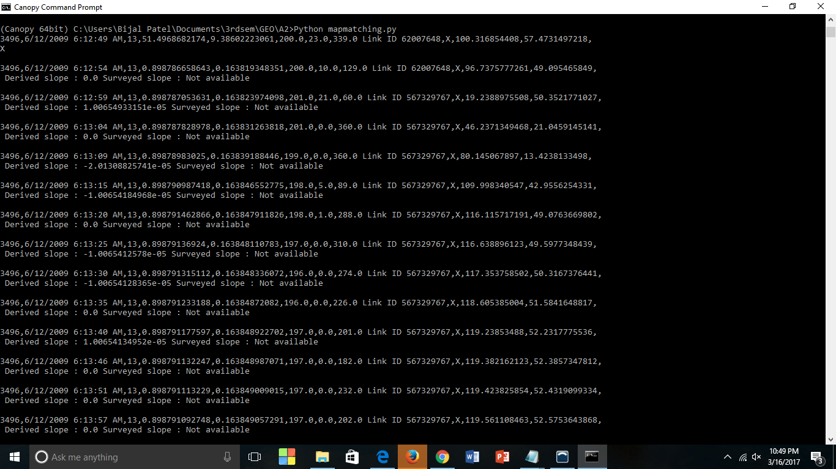
Result

Slide 11
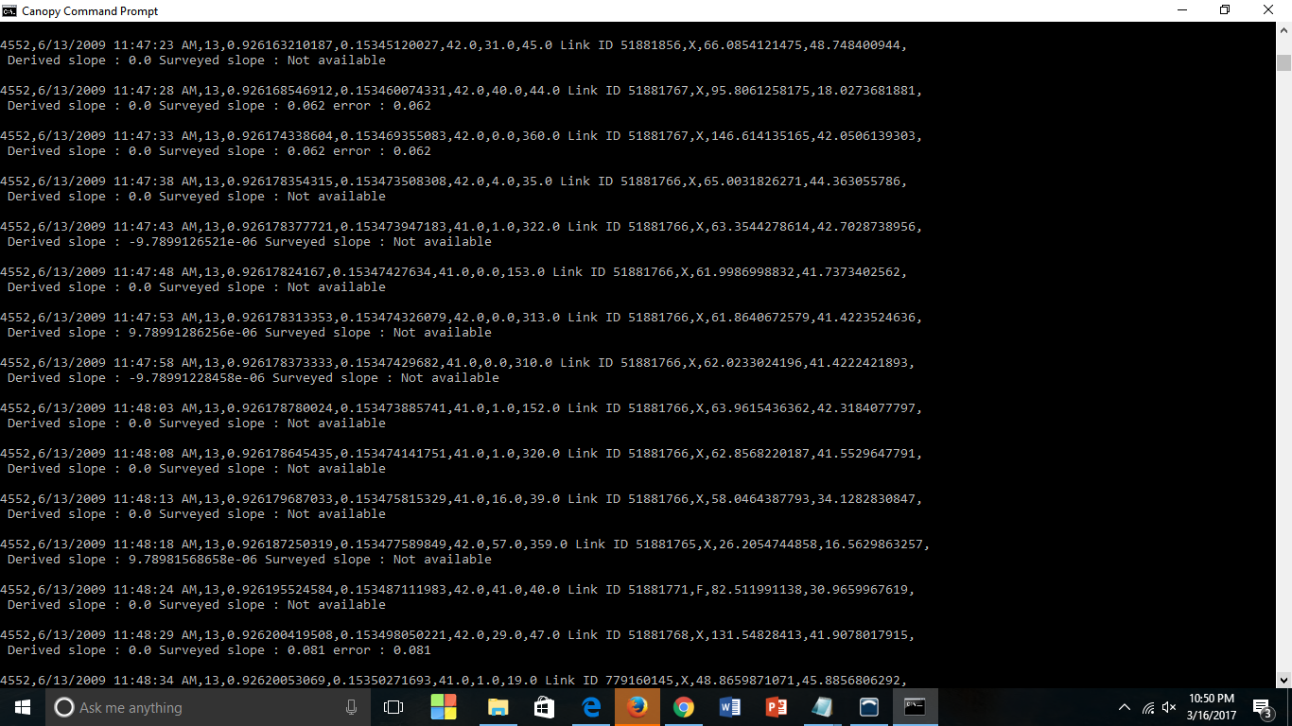

Slide 12
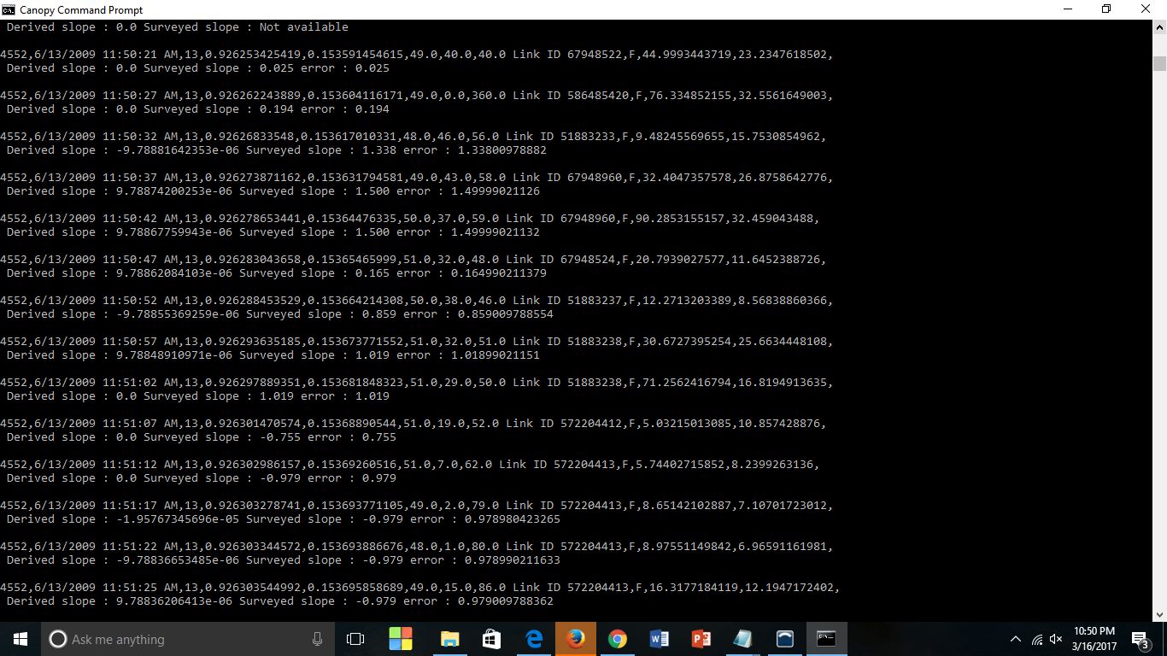

Slide 13
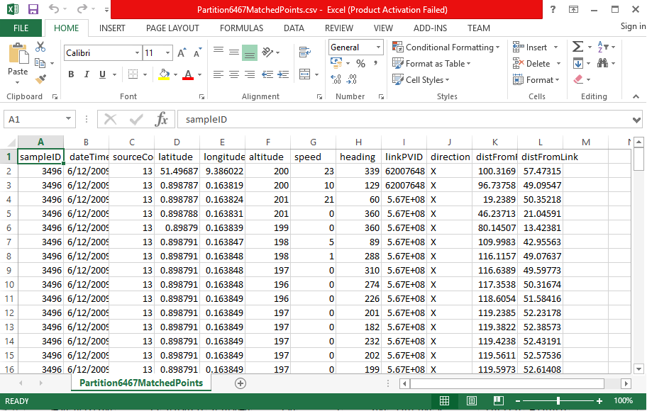

Slide 14
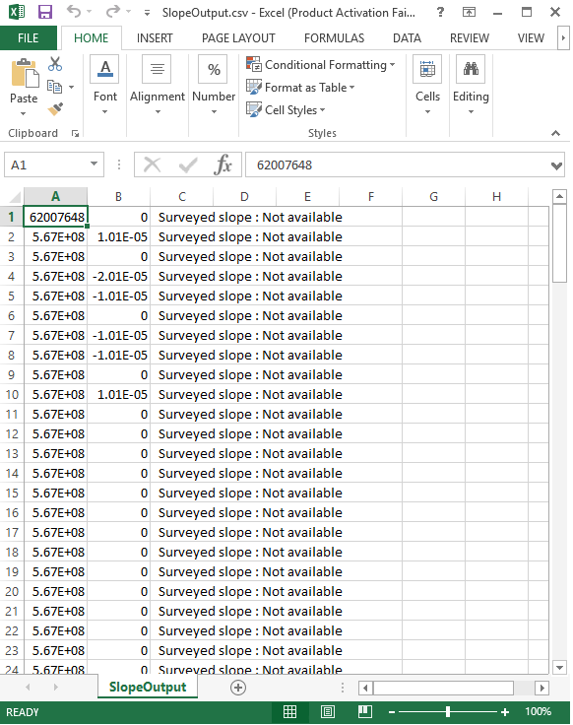
Format of SlopeOutput.csv
linkPVID, derivedSlope, surveyedSlope
linkPVID is a unique identifier for a link.
derivedSlope is the slope calculated for a probe point.
surveyedSlope is the slope for a specific link.

